Slide 1

Collaborative University Android App
Adeel Asghar
Palak Patel
Hala Ali
Tyler Gross
Notes:
Presenter - Adeel

Slide 2
Agenda
Purpose
General Constraints
Functional Requirements
Non-functional Requirements
Database Requirements
Data Flow Diagram
Notes:
Presenter - Hala

Slide 3
Purpose
Functional, nonfunctional, and database requirements list
Contract between developers and clients
Guideline for implementation of software product
Notes:
Presenter – Hala
The purpose of this SRS document tells the developers what the guidelines for the developers have to implement for the client.

Slide 4
General Constraints
MVVM Architecture
Limit on Firebase Realtime Database Reads
4
Notes:
Presenter – Hala
Must adhere to MVVM arch

Slide 5
Functional Requirements
User Registration
User LOGIN
Post on Subscribed Class Forum
Comment on Subscribed Class Forum
Unsubscribe to Class Forum
Notes:
Presenter – Hala Ali

Slide 6
FR 1: User Registration
Introduction | This feature fulfills the initial user contact with the app. The user creates an account in which they will be able to complete further activities in the app and can login after they sign out.
Inputs | The user must input a username, their email address, and a password. When the user selects the button “Register”, the user will be taken to the main forum page.
Processing | The system shall store the username, email, and password into the NoSQL database for future reference. The register button will trigger a new activity screen that is the main homepage of the forum.
Outputs | An account is created for the user and the user is able to create a post.
Error Handling | When the register button is clicked, if the user is not taken to main homepage screen, then a message will appear to the user indicating that there is an error with their inputs. These messages could range from “You already have an account”, “that username or password is already taken”, or “One or more input fields are empty”. If the user already has an account, they can click on the text “Already have an account?” to access the login page and type in their email and password.
Dependencies | Forward Dependencies: FR3.2.2 Backward Dependencies: N/A
Priority | 2
Notes:
Presenter – Adeel

Slide 7
FR 2: User Login
Introduction | This feature is responsible for registered users connecting to the app and gaining access to all the forums they are subscribed to.
Inputs | The user must input an email and password. When the user selects the button “Login”, they will be taken to the main homepage screen.
Processing | The system shall check the firebase NoSQL database entity known as “user” in order to match the user input with the stored emails and password. If a match is found, the user will be connected to their homepage.
Outputs | The user is taken to the main homepage screen where they can view all the posts of the forums they have subscribed to.
Error Handling | After the user has entered their email and password and clicked “Login”, if the user is not taken to the main homepage, an error message will be presented to the user. That error message will be “the email and/or password entered is incorrect”. If the user does not have an account, they can click on the “Register for an account” text and complete the steps on that screen. However, if they forget their password, a screen will be taken so they can enter their email and click the button “reset password.” Then an email message will be sent to them with steps on how to reset their password.
Dependencies | Forward Dependencies: FR3.2.2, FR3.2.3, FR3.2.4, FR3.2.5, FR3.2.6, FR3.2.7, FR3.2.8, FR3.2.9 Backward Dependencies: FR3.2.1
Priority | 1
Notes:
Presenter – Adeel

Slide 8
FR 3: Post on Subscribed Class Forum
Introduction | The user can create their own posts to all forums in which they have subscribed to.
Inputs | The user must include a title to their post in the title field and type their post in the text field. Once the user is finished, they click the button “Add post.”
Processing | The system shall observe the fields and wait for the user to click on “Add post.” Once the user has clicked it, the post will be saved to the firebase database and the recycler view will read the data from the database and display it on the screen to the user.
Outputs | The post, along with its title, will be added to the forum and all subscribed members of that forum would be able to view the user’s post.
Error Handling | If the user’s post is not added after the “Add post” button is clicked, an error message will be presented to the user that the input field is empty if they have not typed anything or an error message will appear to user that the button does not work.
Dependencies | Forward Dependencies: N/A Backward Dependencies: FR3.2.2, FR3.2.3
Priority | 4
Notes:
Presenter – Adeel

Slide 9
FR 4: Comment on Subscribed Class Forum
Introduction | The user can create their own comments related to any post in a forum that they are subscribed to.
Inputs | The user must type their comment in the text field. Once the user is finished, they click the button “Add comment”.
Processing | The system shall observe the fields and wait for the user to click on “Add comment.” Once the user has clicked it, the comment will be saved to the firebase database and the recycler view will read the data from the database and display it on the screen to the user.
Outputs | The comment will be added to the related post on the forum and all subscribed members of that forum will be able to view the user’s comment.
Error Handling | If the user’s comment is not added after the “Add comment” button is clicked, an error message will be presented to the user that the text field is empty if they did not type anything or that the button does not work if there is text.
Dependencies | Forward Dependencies: N/A Backward Dependencies: FR3.2.2, FR3.2.3, FR3.2.4
Priority | 6
Notes:
Presenter – Hala Ali

Slide 10
FR 5: Unsubscribe to Class Forum
Introduction | The user can unsubscribe from a forum that they are currently subscribed to. This means that the user will no longer view activity on that forum or be able to participate in it by posting and commenting.
Inputs | The user will click on the “-” sign next to the class forum.
Processing | The change shall be caught by a listener on the view model that will trigger the firebase to update that user’s list of subscribed classes by removing the class they initially subscribed from. By doing so, changes to the database will be reflected back to the user from the view model and all the activity pertaining to the now unsubscribed forum will be gone.
Outputs | After the user clicks “-” next to the class forum they would like to unsubscribe from, posts and comments on that forum page will no longer be seen on the user’s main homepage screen. After the user clicks “-” next to the class forum they would like to unsubscribe from, posts and comments on that forum page will no longer be seen on the user’s main homepage screen.
Error Handling | If the user is still subscribed to the class forum after they click “unsubscribe,” an error message will appear to the user saying that the button does not work.
Dependencies | Forward Dependencies: N/A Backward Dependencies: FR3.2.2, FR3.2.3
Priority | 8
Notes:
Presenter – Hala Ali

Slide 11
Nonfunctional Requirements
Performance
Maintainability
Portability
Notes:
Presenter - Palak

Slide 12
Database Requirements
DATA Selection
DATA Design
DATA Integrity
Notes:
Presenter - Tyler

Slide 13
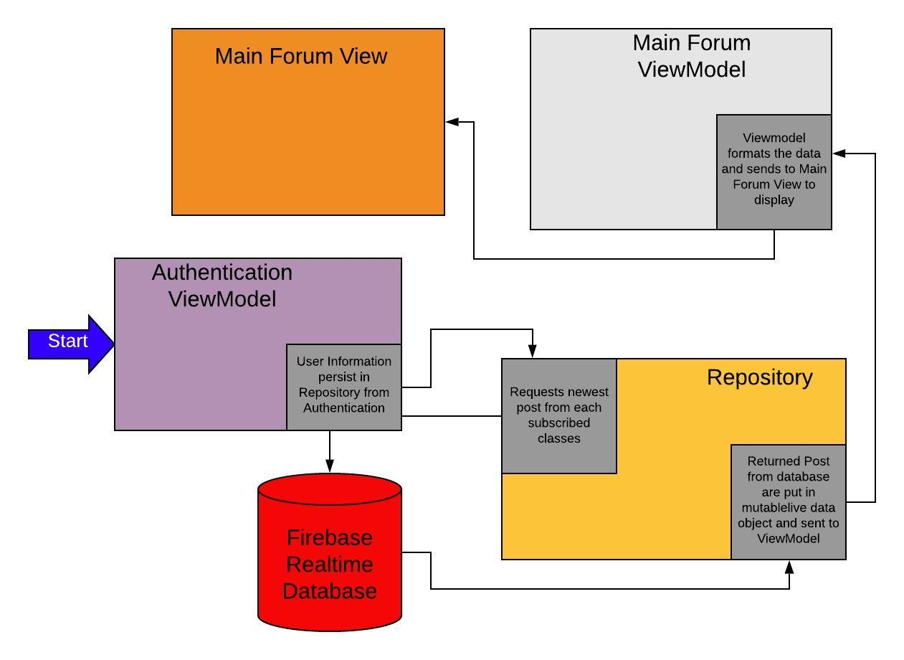
Data Flow Diagram: Load Posts
Notes:
Presenter - Tyler

Slide 14

Questions
Notes:
Presenter - Tyler

